Slide 1
CREATING LANDMARKS WITH GFRC FACADES
BRIEF - TECH DETAILS - COSTING
GRC GRILLS – JALIS

Slide 2
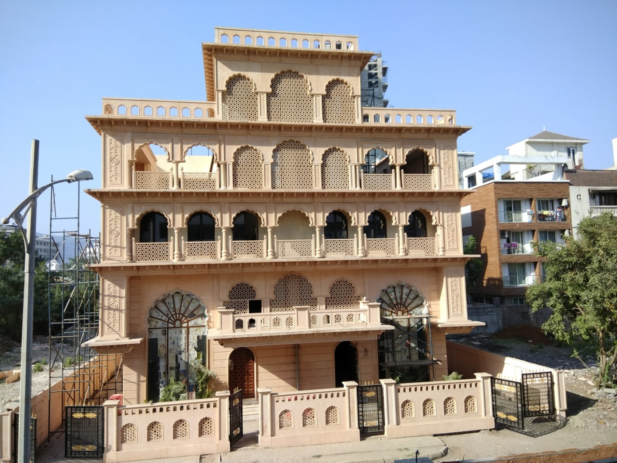
DECORATIVE JALI – RAJASTHANI HAVELI
FOR WINDOW ARCHES & BALCONY RAILINGS

Slide 3
BRIEF ON - GRC GRILLS
BASED ON YOUR PROJECT REQUIREMENTS
BASED ON DESIGN,
% OF PERFORATIONS, SIZE OF MODULE, ETC THE GRC GRILL THICKNESS FROM 25 TO 100 MM IS POSSIBLE,
EACH MODULE SIZE OF AROUND 25 SQFT WITHIN - WHATEVER DIMENSION / SIZE AS PER YOUR DESIGN DETAIL IS POSSIBLE.
25 SQFT OF AREA IS A IDEAL SIZE WILL WEIGH AROUND 80 – 1 10 KGS, HOWEVER LARGER SIZE SCREENS ARE ALSO VERY MUCH POSSIBLE.
THE THICKNESS WILL DEPEND ON THE OPEN / PERFORATED AREA IN A SCREEN.

Slide 4
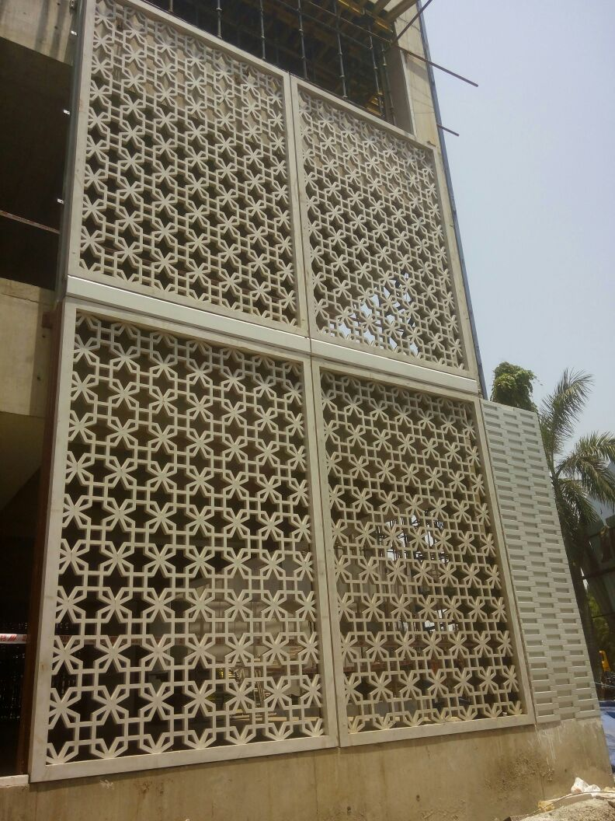
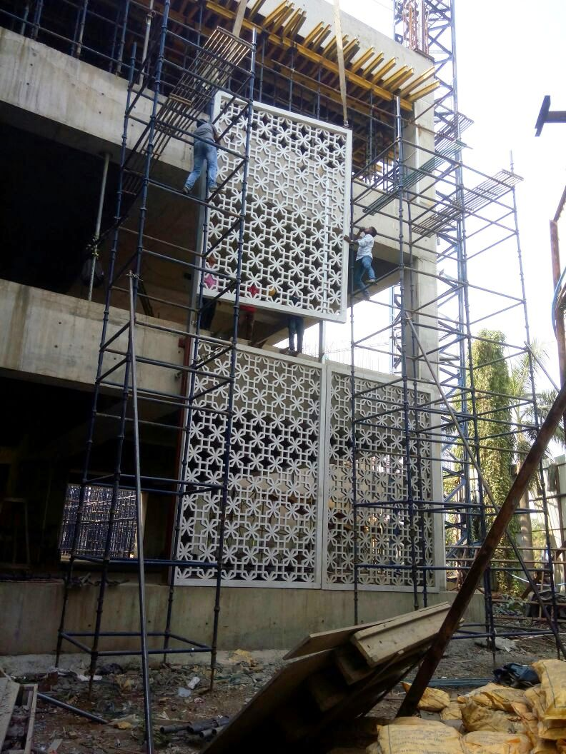
THE FAÇADE GRILL
OUTER BANDS 100MM & GRILL MODULE BEING 60MM THICK
EACH GRILL 14’ X 9’
WEIGHT – .8 TON EACH

Slide 5
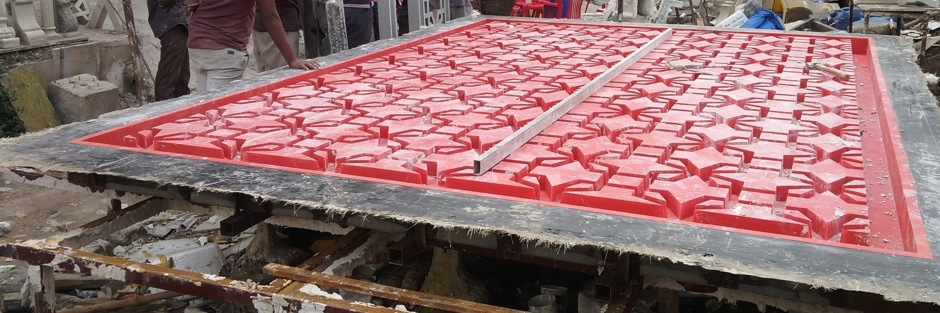
THE PATTERN & RUBBER MOULD
GRILL AREA BEING 126 SQ.FT, THE ELEMENT WAS LIFTED THRU A CRANE AS THE MOULD & GRC ELEMENT WEIGHED AROUND 2 TONS, AND THIS MOULD ITSELF COSTED RS. 15 LAKHS. THE ARCHITECT & CLIENT LATER DECIDED TO MOVE FORWARD WITH A NEW DESIGN

Slide 6
BRIEF ON - GRC GRILLS
BASED ON YOUR PROJECT REQUIREMENTS
BASED ON THE PATTERN & EACH MODULE SIZE, (MODULE SHOULD GET FRAME STRUCTURE SUPPORT TO SCREW FIX GRC PANEL AT ALL 4 CORNER JUNCTION) A SUITABLE RIGID GRID OF MS STEEL FRAMEWORK (50, 75, 100MM SQ.PIPES) OF 5 MM THICKNESS, IF 50 MM SQ.
PIPES ARE PROVIDED THEN 50 X 50 X 5 MM ANGLE PIECES OF 6 INCHES ON EACH SIDE, TO BE WELDED AT DESIRED LOCATIONS FOR PROPER FIXING.
THE GRC GRILLS TO FRAME STRUCTURE, APPROVAL OF THE STRUCTURAL CONSULTANT IS A PREREQUISIT & MANDATORY, AND NOT IN OUR SCOPE OF WORKS.
1 PIECE CAN BE CASTED FROM ONE MOULD OR AT MAXIMUM 2 PIECES, BASED ON YOUR TIMELINES IN A DAY
YOU HAVE TO CONSIDER THE SIZE OF YOUR DESIRED MODULS, TOTAL NUMBER OF MOULDS REQUIRED, IF THE DETAILS OF TIME LINES, THE DESIGN, MODULE SIZE, THICKNESS AND TOTAL QUANTITIES ARE PROVIDED WE WILL BE ABLE TO PROVIDED A PRECISE RATE FOR YOUR PROJECT REQUIREMENT.

Slide 7
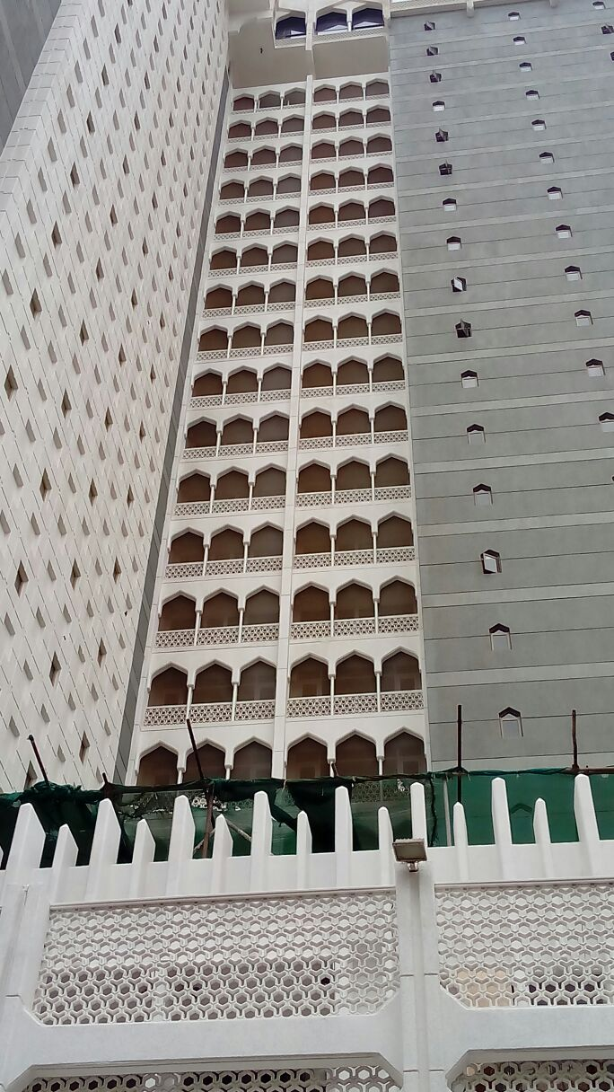
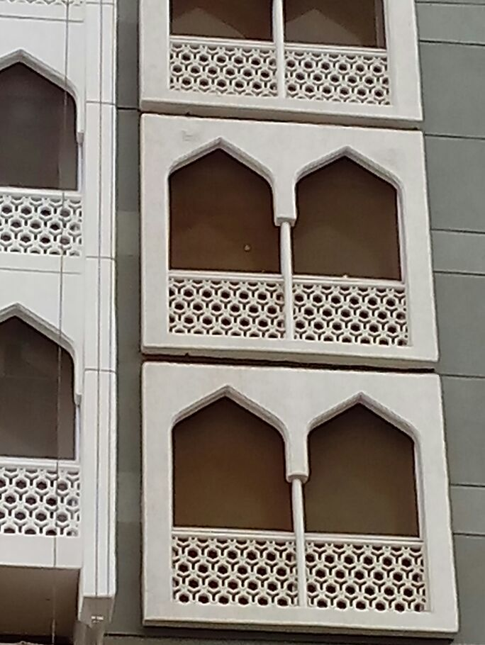
THE TAJ HOTEL MUMBAI
RENOVATED WITH GRC - BALCONY GRILLS & JALIS

Slide 8
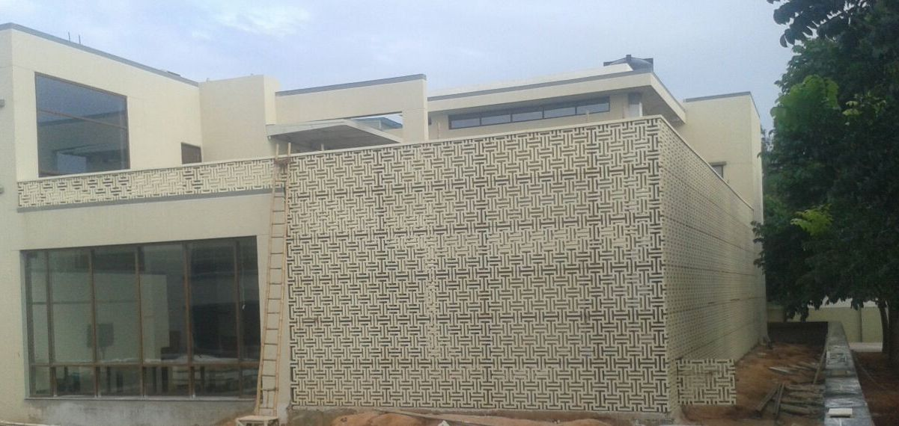
GRC GRILL
COVERING A PRIVATE GARDEN AREA (WITH BACK TO BACK APPLICATION)

Slide 9
Approximate cost price will depend on quantity, design, thickness, size, (mold cost + element cost) + finish including fixing (RATES WILL DEPEND ON QUANTITY)
MOULD MAKING COST PER SQ.FT.
GRC GRILL WITH PERFORATION – GOMETRIC PATTERN IN FRP MOULD – RS. 1200 - 1500 PER SQ.FT
GRC GRILL WITH PERFORATION – FLORAL PATTERN IN RUBBER MOULD – RS. 3300 - 5000 PER SQ.FT
GRC PLAIN PANEL IN FRP MOULD – RS. 1100 – 1500 PER SQFT.
GRC ELEMENT & FIXING COST – PER SQ.FT
GRC GRILL WITH PERFORATION –– RS. 475 PER SQ.FT (RS 375 FOR SUPPLY + RS. 100 FOR INSTALLATION
GRC PLAIN PANEL IN FRP MOULD – RS. 450 PER SQ.FT (RS 375 FOR SUPPLY + RS. 75 FOR INSTALLATION.
FOR STONE FINISH & COLOUR PIGMENTATION + 10% EXTRA (ELIMNATES PAINTING COST)

Slide 10
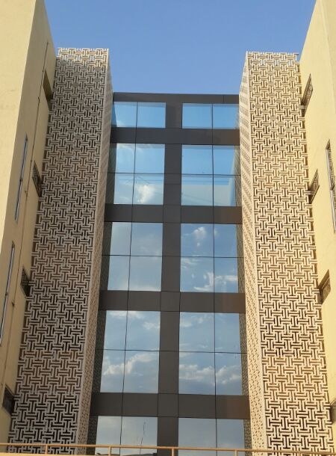
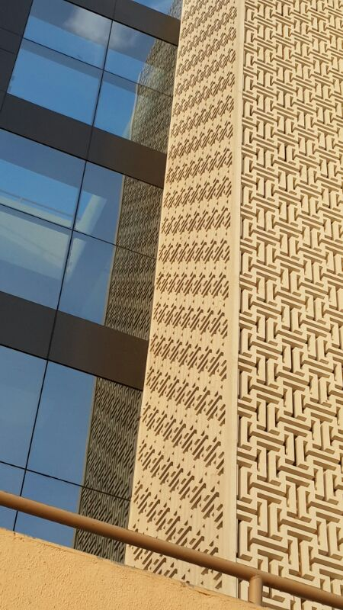
GRC GRILL
USED TO COVER THE STAIRCASE AREA

Slide 11
OTHER TERMS & CONDITIONS
SCAFFOLDING ITS ERRECTION & DISMANTLEING NOT IN OUR SCOPE OF WORKS.
MS/ SS STEEL AND ITS FABRICATION NOT IN OUR SCOPE OF WORKS AND ITS COST TO BE CONSIDERED EXTRA
ANY CURVED PANEL COST WILL BE EXTRA AS PER DESIGN DETAIL
FOR WORKS OUTSIDE MUMBAI / PUNE – FREE ACCOMODATION NEAR / ON SITE WITH WASHROOM / TOILET FACILITY TO BE PROVIDED FOR CASTING & FIXING CREW BY THE CLIENT.
FOR WORKS OUTSIDE MUMBAI / PUNE 5% EXTRA ON BASIC RATES WILL BE APPLICABLE.
IT IS ADVISABLE TO CAST GRC ELEMENTS AT OR NEAR SITE, AS GRC IS A FINISHED ELEMENT AND MOREOVER TRANSPORTATION COSTS FOR SHIFTING FINISHED GOODS COST MORE AND IT ALSO INVOLVES PACKAGING & UNNESSARY LOADING & UNLOADING & DAMAGES DURING TRANSPORTATION.
PAYMENT TERMS
1. GST @ 18% 2. TRANSPORTATION AT ACTUALS (TO BE PAID DIRECTLY TO THE TRANSPORTER) 3. 35% ADVANCE WITH ORDER, 35% BEFORE DESPATCH OF MOULDS & RAW MATERIALS TO SITE, 15 % ON INSTALLATION OF 50% WORKS AND BALANCE ON COMPLETION.

Slide 12
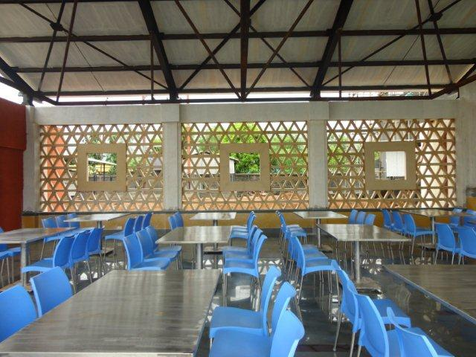
OPEN CELLED GRILL
FOR A SIDE WALL OF A CAFETRIA

Slide 13
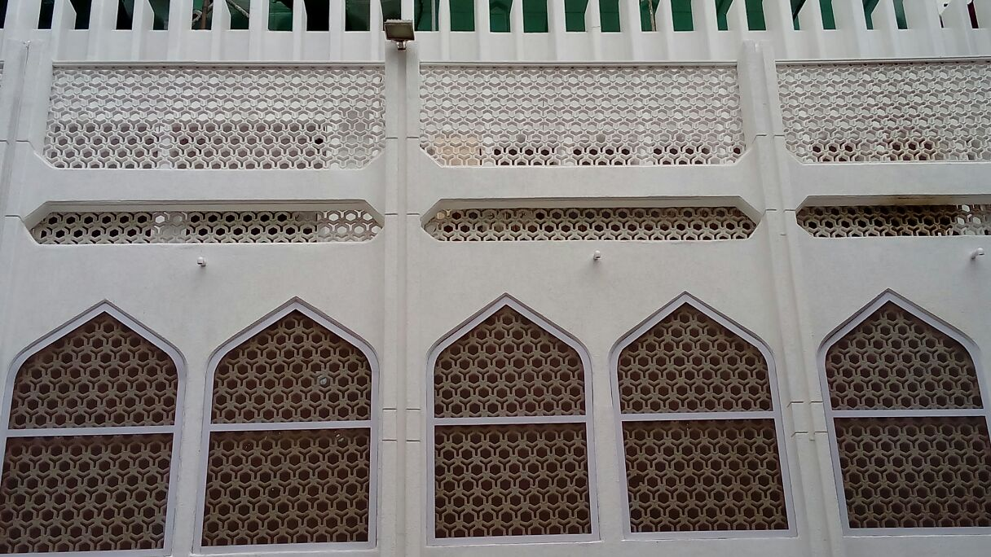
THE TAJ HOTEL MUMBAI
RENOVATED WITH GRC - BALCONY GRILLS & JALIS

Slide 14
ADVANTAGE GRC
THE BENEFITS ARE MANY AND THIS IS THE REASON OF ITS POPULARITY
GRC is not a single material but a family of materials with different properties tailored to suit particular applications.
Lightweight Products - Although GRC has a similar density to concrete, the products made from it are many times lighter due to the thin 10-15mm skin thickness used.
Cladding panel - manufactured from 100mm thick precast concrete would weigh 240kgs per m2 compared to a similar GRC panel of 40-50kgs/m2. In fact many GRC products can be lifted and carried by hand.

Slide 15
ADVANTAGE GRC
THE BENEFITS ARE MANY AND THIS IS THE REASON OF ITS POPULARITY
Corrosion and Rot Proof - GRC products do not contain mild steel reinforcement and the problems associated with corrosion of reinforcement do not apply. GRC is unaffected by external exposure and will not rot. It is completely unaffected by exposure to UV light.
GRC products reduce loadings on buildings leading to significant savings in superstructure and foundations.
GRC is environmentally friendly.
Incombustible - Most GRC formulations comply with non-combustible criteria and conforms to the requirements of Class O defined by the British Building Regulations.

Slide 16
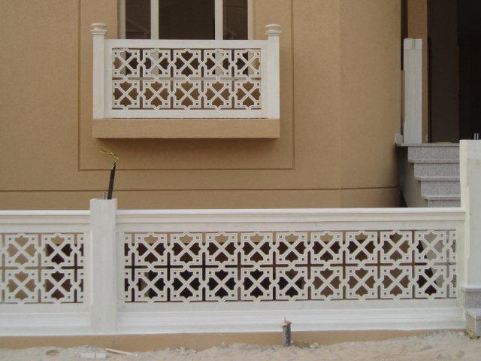
GRILLS ADDING AESTHETICS TO YOUR SPACE

Slide 17
ADVANTAGE GRC
THE BENEFITS ARE MANY AND THIS IS THE REASON OF ITS GAINING POPULARITY
GRC is excellent for reproduction and renovation.
GRC provides the designer with a complete technology that few other materials can match for versatility.
GRC is one of the most popular materials used for creative prefabricated architectural cladding. GRC’s ability to be moulded into thin, lightweight panels with a wide variety of shapes, forms and surface finishes has been appreciated by a growing audience of architects and engineers worldwide.
GRC is easily moulded to reproduce shapes, details and textures
GRC is high strength allows design of thin, lightweight cladding elements
GRC can be coloured with pigments, paints and natural stone facings
GRC cladding can replace non-structural precast concrete where weight and/or shape may be problematic
GRC cladding panels are generally manufactured by the ‘Hand Spray’ technique. As the name implies, the material is sprayed into a mould using special machinery. The method can produce high-performance materials from which panels with extremely thin, lightweight sections are achievable.

Slide 18
CONTACT US
GFRC FACADES.
GFRC / GRC, GRG CEILINGS & PANELS, FRP WORKS, HIGH END DECORATIVE & ARCHITECTURAL WORKS & ACOUSTIC SOLUTIONS WITH EXPERTISE IN HOME THEATRES
SRIHARI NILKAR
MUMBAI
Mobile: 09867569395
nilkarsrihari@gmail.com

